Slide 1

Software Architecture
SSE USTC Qing Ding
dingqing@ustc.edu.cn
http://staff.ustc.edu.cn/~dingqing

Slide 2

Service Architectures

Slide 3


Outline
1
Web Services
2
Web Service Architectures
3
Resource Oriented Architectures
4
Service Oriented Architectures
5
Software as a Service
6
Microservices

Slide 4
Component-based development (CBD)
Overview
-Component-based development (CBD) emerged in the late 1990s as a reuse-based approach to software systems development.
÷It was motivated by the frustration that OO development had not led to extensive reuse as originally suggested.
-Components are more abstract than object classes and can be considered to be stand-alone service providers.
÷Components are defined by their interfaces and in general can be thought of as having two related interfaces: provides and requires.
<<interface>> IProvides
print() getQueue() remove() transfer() register() unregister()
2
<<interface>> IRequires
getPDFile() printerInt()
PrintService

Slide 5
Component Categories and Abstraction
-Software components provide a vehicle for software artifacts reuse, and thereby may be used at all the levels of the software life cycle: analysis, design, implementation, and deployment.
-Hence, there are various kinds of software components:
÷Conceptual components: components at the analysis and design level.
÷Implementation components: development work product components
such as source code files, data files etc.
÷Deployment components: involved in an executable system, such as
dynamic libraries and executables.

Slide 6
-Components may also exist at different levels of abstraction:
÷Functional abstraction: the component implements a single function such as a mathematical function. The provides interface is the function.
÷Casual groupings: the component is a collection of loosely related entities that might be data declarations, functions etc.
÷Data abstractions: the component represents a data abstraction or class in an OO language; the provides interface consists of operations to create, modify and access the data.
÷Cluster abstractions: the component is a group of related classes that work together (called framework); the provides interface is the composition of the provides interfaces of the objects involved.
÷System abstraction: the component is an entire self-contained system (also called COTS product); the provides interface is an API defined to allow programs to access the system commands and operations.

Slide 7
Constructs
«component»
sender : Fax
rreemoottee::FFaaxxPrroot
«component»
receiver : Fax
«component»
sender : Fax
«component»
receiver : Fax
rreemoottee::FFaaxxPrroot
Connector
-Principal constructs used in software component modeling:
÷Component: complex, and physical objects that interact with their environments through one or more ports.
÷Port: boundary object that implements some of the interfaces through which a component interacts with its surroundings.
÷Connector: abstraction for communication channels that interconnect two or more ports of components.
÷Roles: boundary object that implements the interfaces through which a connector interacts with its surroundings.
÷Protocol: defines the valid sequence of messages between connected ports

Slide 8
2. Component-Based Development Processes
-Component-oriented development can be integrated into a system development process in one of two ways: opportunistic reuse and development with reuse.
Opportunistic Reuse
Design System Architecture
Specify Components
Search for Reusable Components
Incorporate Discovered Components
-The specifications are used to find reusable components which are then incorporated in the architecture.
÷Although this approach may result in significant reuse, it contrasts with the approach adopted in other engineering disciplines.

Slide 9
Development with Reuse
Outline system requirements
Search for Reusable Components
Modify Requirements According to Discovered Components
Architectural Design
Design/Find Reusable components
Design system Using Reusable Components
-The system requirements are modified according to the reusable components available; the design is also based around existing components.
÷Since this requires some tradeoff, the design is less efficient than a special purpose design; however, lower costs of development, rapid delivery, and increased system reliability should compensate for that.

Slide 10
3. Component Models
-A software component conforms to a component model and can be independently deployed and composed without modification according to a composition standard.
Component Model
-A component model defines a set of standards for component development, deployment, and evolution.
-The main competing component models currently available include:
÷OMG’s CORBA Component Model (CCM),
÷Microsoft’s Distributed Component Object Model (DCOM)
÷Microsoft DotNET Framework
÷SUN Microsystems JavaBeans and Enterprise JavaBeans (EJB)

Slide 11
Basic Elements of a Component Model
-Basic elements of a component model include standards for interfaces, naming, meta data, customization, composition, evolution, and deployment.
Standards for | Description
Interfaces | Specification of component behavior and interfaces; definition of an Interface Definition Language (IDL)
Naming | Global unique names for interfaces and components.
Meta data | Information about components and interfaces.
Interoperability | Communication among components from different vendors, and/or implemented in different languages.
Customization | Interfaces for customizing components.
Composition | Interfaces and rules for combining components.
Evolution Support | Rules and services for evolving components.
Packaging and deployment | Packaging implementation and resources needed for installing and configuring a component.

Slide 12
Component Model Implementation
-Dedicated set of executable software elements required to support the execution of components that conform to the model.
-Provide:
÷A run-time environment
÷Basic Services
÷Horizontal services that are useful across multiple domains
÷Vertical services providing functionality for a particular domain for software components.

Slide 13
4. The CORBA Component Model (CCM)
Overview of the CCM
-The goals of the CORBA Component Model (CCM), like any other component model (e.g., DCOM, EJB etc.) is to facilitate reuse of CORBA applications.
-The CCM extends the standard CORBA Interface Definition Language (IDL) by including specific features for component description.
-The CCM also introduces a new declarative language, named the Component Implementation Definition Language (CIDL), which is used by code generators to generate code needed to deploy the components (in containers).
-Developers have to deal only with the development of the components and their inherent logic and functionality.

Slide 14
CBD Process using the CCM
Developer
Configurator
Designer
IDL/CIDL/PSDL
Functional code
Home properties
Component properties
IDL/CIDL/PSDL
compiler
CORBA
Component Package
CORBA
Assembly Package
Stubs/ Skeletons
Programming Language Tools
Implementation
Component descriptor
Assembling Tool
Packaging Tool
Softpkg descriptor
Integrator
Assembly description
Default properties
Deployment Tool
Provider
Administrator

Slide 15




Component Model
Component
Receptacles (uses)
Facet (supports)
Facets (provides)
Event sink (consumes)
Event source (publishes, emits)
Attributes
-The CCM defines a component type to represent component instances.
-Component type definitions consist of a collection of ports definitions.
The CCM defines 2 kinds of ports: facets and configuration ports.
÷Facets: consist of a set of interfaces that define the functionality supported or provided by the component.
÷Configuration ports: correspond to a set of interfaces that specify how a component may interconnect and communicate with other components.

Slide 16
Configuration Ports
Several kinds of ports supported by the CCM, namely receptacle, attribute, emitter, publisher, and consumer.
-Receptacles: specify the external dependencies of the component, by describing the interfaces used by the component.
-Attributes: describe the properties of the component, and thereby serve as medium for their configuration and customization.
-Event sources: specify the events published by the component;
two forms of events can be generated by the component:
÷Publisher: events for which the component is exclusive provider
÷Emitters: events that share event channels with other event sources
-Event sinks: specify the events consumed by the component.

Slide 17
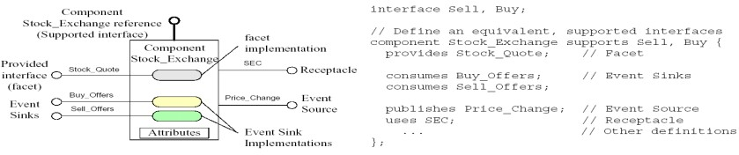
CCM Examples
An example CCM Component

Slide 18
An example CCM Component With IDL Specification

Slide 19
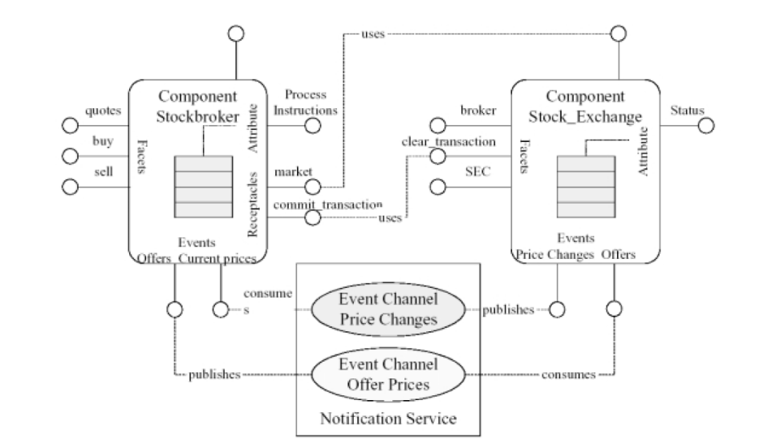
Example of CCM Components Interactions
Note: CCM components interact through port mechanisms

Slide 20
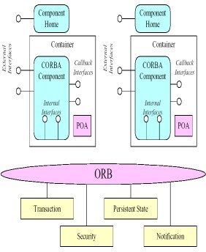
Component Container
-Represents the run-time environment of component instances.
÷The CORBA component container implements component access to global system services such as transactions, security, events, and persistence.
÷The container reuses the existing CORBA infrastructure. In doing so, the inherent complexity of CORBA is hidden both to the developer and to the container.
-Container and component instances interact through two kinds of interfaces:
÷Internal API: a set of interfaces provided by the container to component implementations.
÷Callback Interfaces: a set of interfaces provided by component
implementations to the container.

Slide 21
Web Services
Service Architecture for the Web

Slide 22
Web as a database
The Web we use is full of data
Book information, opinions, prices, arrival times, blogs, tags, tweets, etc.
The data is organized around a simple data model: node-link model Each node is a data item that has a unique address and a
representation
Representation formats are e.g. HTML, PDF,... for humans, or e.g XML, JSON for programs
Nodes can be interlinked using their unique addresses

Slide 23
Web as a platform for distributed systems
The Web is full of services that allow humans and programs to use the Web data
Services also have unique addresses
They use a particular representation for data exchange, e.g. XML, SOAP, WSDL
Services follow a particular architecture that deﬁnes how services are used
Programmers combine a number of services to achieve a desired functionality and create a distributed system, e.g. mashups

Slide 24
Types of services
What is the Google search engine?
It is a service for querying a massive database (Web search index)
What is a given Web application?
It is a service oﬀering (remotely) a speciﬁc functionality
What is a Web site?
It is a service oﬀering speciﬁc human consumable information

Slide 25
Types of services
All of these services are for users
However, we are interested in services for programmers Such services provide an API
Programmers use the API, unique addresses, representations of services
Programmers follow the arch. style to integrate and combine services to achieve a desired functionality
We will call this part of the Web: the programmable Web

Slide 26
Kind of Things on the Programmable Web
There are numerous approaches to web services in all areas
The programmable Web is based on HTTP for data transport and in most cases XML or JSON for data representation
However, some services serve HTML, plain text, binary data, etc. Also, other things such as addressability or APIs are diﬀerent
We need a classiﬁcation!

Slide 27
Classiﬁcation based on architectural design
Which operation should a service execute? This is method information
What data should be manipulated? This is scoping information

Slide 28
Method information
Question: how the client conveys its intention to the server?
How does a server know a certain request is a request to retrieve some data?
Instead of a request to delete the same data?
Why should the server do this instead of doing that

Slide 29
Web Service Architectures
REST & Web-Services

Slide 30
Competing Architectures
Resource-Oriented Architectures (RESTful)
RPC-Style Architectures (SOA)
REST-RPC Hybrid Architectures

Slide 31
Resource-Oriented Architectures
Resource-Oriented Architectures
Descriptive URLs
URLs reﬂect the application state Inherit semantic from HTTP methods Should be stateless
Limited by its simplicity (limited HTTP methods, ...)

Slide 32
RPC-Style Architectures
RPC - Remote Procedure Call
An RPC style service receives an envelope full of data from the client
The service answers with a similar envelope again full of data to the client
Both method and scoping information are inside of the envelope HTTP methods typically POST but sometimes also GET

Slide 33
RPC-Style Architectures
The best example of the envelope format is SOAP There exist other envelope formats like XML-RPC
Every RPC-style service deﬁnes a completely new vocabulary
E.g. the way how method information and scoping information are represented
You need another language to deﬁne the representation: e.g. WSDL

Slide 34
Problems of RPC-Style Architectures
RPC implies an API
APIs tend to enforce tight coupling of modules and systems We use declarative XML to describe APIs
This introduces processing overhead

Slide 35
REST-RPC Hybrid Architectures
REST-RPC Hybrid Architectures
Inherit parts from REST and RPC style architectures
Used by many Web Site for their API (e.g. Flickr, del.icio.us, ...)

Slide 36
Resource Oriented Architectures
Theory Behind REST

Slide 37
Resource Oriented Architectures
4 deﬁning features of ROA
Addressability: the scoping information is kept in the URL
Uniform interface: the method information is kept in the HTTP method
Statelessness: every HTTP request is isolated from other requests
Connectedness: you link resources into the Web of resources

Slide 38
Addressability
Resources are exposed through URLs - an application exposes a number of URLs
When you have URLs you bookmark, cache responses, chain URLs,
...
Many Web applications do not work this way, i.e. they are not addressable, e.g. GMail

Slide 39
Uniform interface
Standardized HTTP methods: CRUD operations (Create, Retreive, Update & Delete)
Two principles
Safety: GET only reads data
Idempotence: the same operation has the same eﬀect whether you apply it once or multiple times

Slide 40
Statelessness
Every request contains all necessary information
There is no state managed on the server side
In fact, there are two kinds of state
You should distinguish between the application state and resource state
Application state lives on the client Resource state lives on the server

Slide 41
Statelessness
When you use a search engine your current query and your current page belongs to application state
They are diﬀerent for every client
Resource state is same for every client, i.e. search index A crawler can update the search index

Slide 42
Links and connectedness
Representations of resources, i.e. HTML or XML might have links to other resources
Axiom for ROA services: Hypermedia as the engine of application state
The current application state is not stored on the server as a resource state
It is tracked by the client as an application state and created by the path that client takes through the Web

Slide 43
Links and connectedness
For example http://www.google.com/search?q=jellyfish
The ﬁrst page is the starting application state You have links to other application states Obvious for the human Web

Slide 44
Links and connectedness
<Buckets>
<Bucket>
<Name>crummy.com</Name>
<URL>https://s3.amazonaws.com/crummy.com</URL>
<CreationDate>...</CreationDate>
</Bucket>
...
</Buckets>
Following the link in the URL element takes the client to a new application state
Use links, links, and then use more links, ...

Slide 45
Designing ROA
Figure out data set
Split the data set into resources Then, for each resource
Name the resources with URLs
Expose a subset of the uniform interface

Slide 46
Designing ROA
Design representations accepted from the client
Design representations served to the client
Integrate this resource into other resources using links
Consider possible application states
Consider possible error states

Slide 47
Example
Application similar google maps: maps of cities, streets, planets,... Data set: Maps, points, cities, planets, ....
Resources: list of resources, individual resources, results of algorithms applied to the data set
Example resources: the list of planets, Mars, Earth, San Francisco, Inﬀeldgasse, ...
An algorithmic resource: a list of places that match certain criteria - all cities with more than 1 million of people

Slide 48
Example
Name the resources: create meaningful URLs
http://maps.example.com/Earth
http://maps.example.com/Earth/France/Paris
http://maps.example.com/Earth/Austria/Cities
http://maps.example.com/Earth/Germany/Cities?pop=1000000

Slide 49
Example
Design representations
A representation talks about resource state
A representation links to other (application and resource) states
http://maps.example.com/Earth/Austria →
http://maps.example.com/Earth/Austria/Cities
http://maps.example.com/Earth/Austria/Cities → http://maps.example.com/Earth/Austria/Vienna

Slide 50
Read/Write ROA systems
User accounts should be resources
To access these resources you need to use HTTP authentication
  https://maps.example.com/user/rkern
Connect with the previous resources: e.g. custom places on a map
  https://maps.example.com/user/rkern/Earth/Graz/Inﬀeldgasse/oﬃce

Slide 51
Method Semantic in ROA systems
The HTTP method implies the semantics Use GET to retrieve (read the content)
GET https://maps.example.com/user/rkern
Use PUT to write (modify the content)
PUT https://maps.example.com/user/rkern
+ Content
Use DELETE to write (remove the resource)
DELETE https://maps.example.com/user/rkern
⇒ limited to the methods supported by HTTP

Slide 52
REST
REST (Representational State Transfer) No strict typing
Typically XML as data format
Concepts (RESTful) describes constrains: client-server, stateless, cacheable, layered system, code on demand, uniformity
Nowadays, REST is often used a umbrella terms for related architectures

Slide 53
RESTful frameworks
Ruby on Rails with a plugin
Django in Python
Restlet in Java (http://www.restlet.org/)
Jersy

